Slide 1
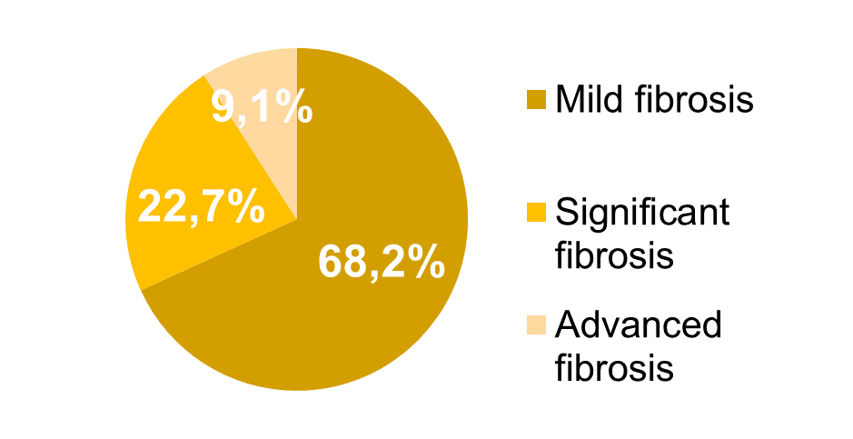
Is NAFLD the same disease in HIV infected patients?
Sara Policarpo^{1,2}, Mariana V. Machado^{3,4}, Carolina Simões³, Ana Craciun³, Helena Cortez-Pinto^{2,3,4}
1. CHULN - Hospital Santa Maria, Serviço de Dietética e Nutrição, Lisboa, Portugal; 2. Laboratório de Nutrição, Faculdade de Medicina, Universidade de Lisboa, Portugal
3. CHULN – Hospital de Santa Maria, Departamento de Gastrenterologia, Lisboa, Portugal; 4. Clínica Universitária de Gastrenterologia, Faculdade de Medicina, Universidade de Lisboa, Portugal
Background
With the worldwide growing incidence of obesity, nonalcoholic fatty liver disease (NAFLD) has been recognized as a global major health burden ⁽¹⁾ and a key point in the clinical management of PLHIV ⁽²⁾ since it is currently considered as a major contributors to the burden of liver disease amongst PLHIV.^{(3,4)}
Results
From the 157 patients referred; 32 declined participation and 13 patients were excluded (hepatitis C infection and/or excessive alcohol intake); 75 had complete data and were included in this analysis. Although less than 20% of patients presented abnormal liver enzymes, 58.7% had NAFLD (n=44) (Table 1).
Table 1: Patient characteristics
 | HIV patients | NAFLD HIV Patients (n=44) | No-NAFLD HIV Patient (n=31) | P-value
Age (yrs.) | 53.4±11.6 | 53.5±10.2 | 53.2±13.2 | >0.05
Sex (% Male Female | 72 28 | 72.7 27.3 | 71 29 | >0.05
Comorbidities (%) Diabetes Hypertension Dyslipidemia | 16 42.7 45.3 | 13.6 45.5 52.3 | 19.4 38.7 35.5 | <0.001 >0.05 >0.05
TCD4+≥500cel/mm3 (%) Yes No | 86.7 13.3 | 90.9 9.1 | 80.6 19.4 | 0.031
BMI (kg/m2) | 26.4±4.4 | 27.4±4.2 | 25.0±4.4 | 0.017
BMI category (%) Normal (18.5-24.9kg/m2) Excess weight (25-29.9kg/m2) Obesity (>30kg/m2) | 36.0 46.7 17.3 | 29.5 47.7 22.2 | 45.2 45.2 9.7 | >0.05
Waist circumference (cm) | 95.2±10.9 | 98.1±10.1 | 90.5±10.4 | 0.004
Increased Liver Enzymes (%) AST ALT GGT | 13.3 16.0 24.0 | 9.1 15.9 31.8 | 19.4 16.1 12.9 | <0.001 >0.05 0.059
NAFDL HIV Patients
Only 45.5% had a score≥3 on the abdominal ultrasound.. Mean CAP was 281±43Kpa and 9.1% (n=9) of patients presented advanced fibrosis (Fig1).
Aim
Determine the prevalence of NAFLD in HIV patients and compare it with non-infected NAFLD patients.
Methods
Inclusion: HIV patients without known liver disease regularly followed in a tertiary university hospital
We collected clinical ([including liver biochemistry, NAFLD Fibrosis Score (NFS)⁽⁵⁾ and FIB4]⁽⁶⁾ and anthropometric data and patients performed transient hepatic elastography and abdominal ultrasound.
Exclusion: Patients with opportunistic diseases, hospital admission in the previous 3 months and on hepatotoxic drugs were excluded.
HIV-NAFLD patients were compared with non-HIV NAFLD patients from the Hepatology Outpatient Clinic.
Fig 1.: Fibrosis characteristics in HIV patients
As for non-invasive scores NFS did not show significant differences between fibrosis categories. FIB4 differed significantly between categories (p=0.01), with advanced fibrosis presenting higher score (1.6±0.6) compared with significant fibrosis (0.9±0.3) and mild fibrosis (1.1±0.3). However mean values were below the recommend cut-off for the detection of fibrosis.
NAFDL HIV Patients vs. NAFDL non HIV Patients
Compared to 67 non-HIV NAFLD patients, gender and age were similar, but HIV-NAFLD patients were leaner (BMI 27.5±4.2 vs. 31.3±5.6kg/m2; p<0.001) and presented lower AST levels (24±9 vs. 45±29IU/L; p<0.001), ALT (30±19 vs. 63±46IU/L; p<0.001) and GGT (62±35 vs. 101±75IU/L; p<0.001). HIV-NAFLD patients more frequently presented advanced fibrosis compared to non-HIV NAFLD patients (p<0.001)
Conclusions
NAFLD is highly frequent in compensated HIV patients, and present more frequently with advanced fibrosis as compared to non-HIV NAFLD patients, despite lower BMI and lower liver enzymes.
In fact, non-invasive scores did not seem to accurately discriminate advanced fibrosis in HIV-NAFLD patients.
References
1. Lonardo A, et al. Nonalcoholic fatty liver disease: Evolving paradigms. World J Gastoenterol 2017 Sep 28;23(36):6571-6592
2. Maurice JB, Patel A, Scott AJ, Patel K, Thursz M, Lemoine M. Prevalence and risk factors of nonalcoholic fatty liver disease in HIV-monoinfection. Aids. 2017;31(11):1621–32.
3. Vodkin I, Valasek MA, Bettencourt R, Cachay E, Loomba R. Clinical, biochemical and histological differences between HIV-associated NAFLD and primary NAFLD: A case-control study. Aliment Pharmacol Ther. 2015;41(4):368–78.
4. Verna EC. Non-alcoholic fatty liver disease and non-alcoholic steatohepatitis in patients with HIV. Lancet Gastroenterol Hepatol. 2017;2(3):211–23.
5. Angulo P, Hui JM, Marchesini G et al. The NAFLD fibrosis score A noninvasive system that identifies liver fibrosis in patients with NAFLD. Hepatology 2007;45(4):846-854
6. Sterling RK, et al. Development of a simple noninvasive index to predict significant fibrosis patients with HIV/HCV co-infection. Hepatology 2006;43:1317-1325
Contact Information sarapolicarpo@medicina.ulisboa.pt
PRESENTED AT THE 23RD INTERNATIONAL AIDS CONFERENCE (AIDS 2020) | 6-10 JULY 2020

